Slide 1
Travelling Salesman Problem

Slide 2
Assignment Problem
An assignment problem is a particular case of a transportation problem where the resources (say facilities) are assignees and the destinations are activities (say jobs).
Given n resources (or facilities) and n activities (or jobs), with effectiveness (in terms of cost, profit, time, etc.) of each resource for each activity.
Then problem becomes to assign (or allocate) each resource to only one activity (job) and vice-versa so that the given measure of effectiveness is optimized

Slide 3
Number of workers = Number of jobs.
Each worker is assigned only one job.
Each worker is independently capable for handling any job.
Assigning criteria is either minimizing cost or maximizing profit.
Important Points

Slide 4
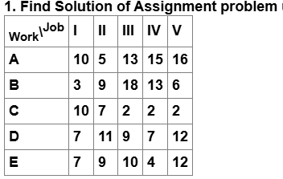
Example

Slide 5
Travelling Salesman Problem
The travelling salesman problem may be solved as an assignment problem, with two additional conditions on the choice of assignment.
How should a travelling salesman start from his home city (the city from where he started), visiting each city only once and returning to his home city, so that the total distance (cost or time) covered is minimum.
For example, given n cities and distances dᵢⱼ (cost cᵢⱼ or time tᵢⱼ ) from city i to city j, the salesman starts from city 1, then any permutation of 2, 3, . . ., n represents the number of possible ways of his tour.
Thus, there are (n – 1)! possible ways of his tour. Now the problem is to select an optimal route that is able to achieve the objective of the salesman.

Slide 6
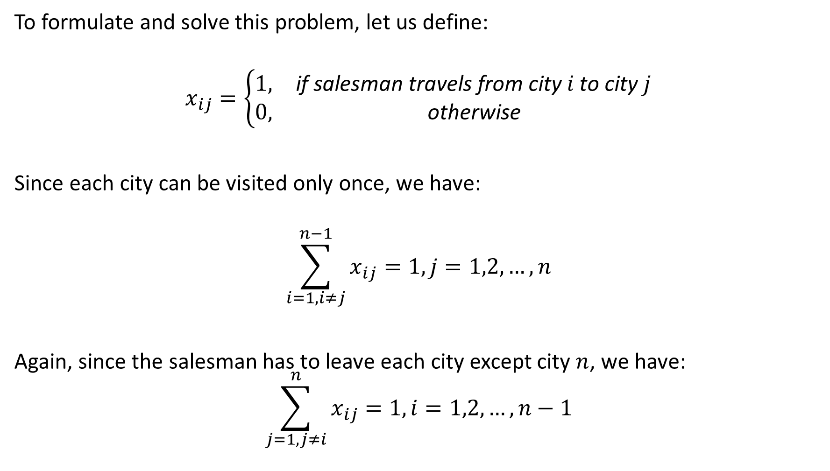
To formulate and solve this problem, let us define:
$$x_{ij}=\left\{\begin{matrix}1, & \text{if} \text{salesman} \text{travels} \text{from} \text{city} i \text{to} \text{city} j \\ 0, & \text{otherwise}\end{matrix}\right.$$
Since each city can be visited only once, we have:
$$\sum_{i=1,i≠j}^{n−1}{x_{ij}}=1, j=1,2,…,n$$
Again, since the salesman has to leave each city except city $n$, we have:
$$\sum_{j=1,j≠i}^{n}{x_{ij}}=1, i=1,2,…,n−1$$

Slide 7


The objective function is then Since $d_{ji}=d_{ij}$is not required, therefore $d_{ij}=∞$for $i=j$. However, all $d_{ij}$s must be non-negative, i.e., $$d_{ij}≥0 \text{and} d_{ij}+d_{jk}≥d_{ik} \text{for} \text{all} i,j,k.$$
$$\min{Z}=\sum_{i=1}^{n−1}{\sum_{j=1}^{n}{d_{ij}x_{ij}}}$$

Slide 8
Need Of TSP
Supply Chain Management: Efficient routing between warehouses, factories, and retail stores.
Manufacturing: Planning tool paths for machines like drilling, painting, or cutting to reduce operation time.
Travel Planning: Designing tours for salespeople, tourists, or service technicians to cover multiple locations efficiently.
Network Design: Optimizing wiring, cabling, or data routing in telecommunication and computer networks.
Scheduling and Planning: School bus routing, garbage collection, postal delivery routes.
Benchmark for Optimization: TSP is used in research to test algorithms for combinatorial optimization and AI routing problems.

Slide 9
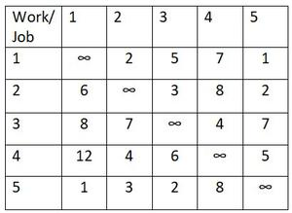
Example: A travelling salesman has to visit five cities. He wishes to start from a particular city, visit each city once and then return to his starting point. The travelling cost (in ’000 Rs) of each city from a particular city is given below:

Slide 10
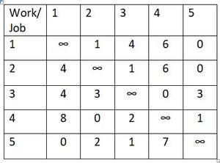
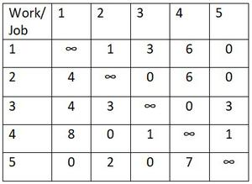
Step 1 Subtract smallest element from each row
Step 2 Subtract smallest element from each column

Slide 11
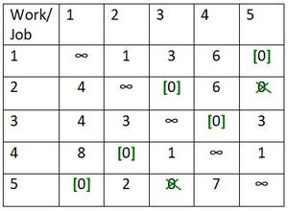
Step 3 Make assignment in the matrix
The number of assignment is equal to the number of cities and the tour is 1->5->1 and 2->3->4->2
Hence this solution is not the optimal solution to the travelling salesman problem

Slide 12
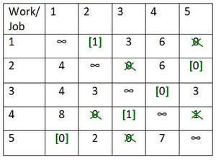
Step 4 The next best solution can be obtained by bringing the minimum non-zero element
1→2→5→1
This is also not the solution

Slide 13
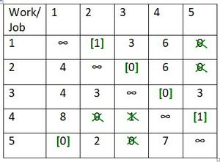
Step 5 Make different possible assignment
The sequence is 1->2->3->4->5->1. So, this solution is optimal and total distance of this tour is
Min Cost =2+3+4+5+1 =15.

Slide 14
Example 2
Work | A | B | C | D | E
A | M | 5 | 8 | 4 | 5
B | 5 | M | 7 | 4 | 5
C | 8 | 7 | M | 8 | 6
D | 4 | 4 | 8 | M | 8
E | 5 | 5 | 6 | 8 | M

Slide 15
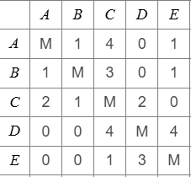
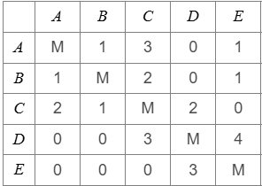
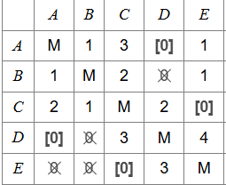
1 Row Minimization
2 Column Minimization
3 Assignment in the matrix

Slide 16
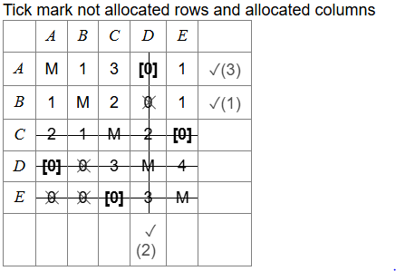

Slide 17
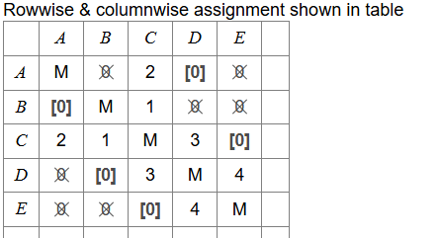
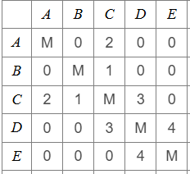
Step

Slide 18
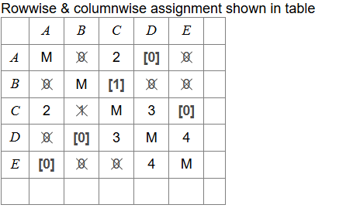
Number of assignments = 5, number of rows = 5
The solution gives the sequence : A→D,D→B,B→C,C→E,E→A
Solution is optimal: A→D→B→C→E→A
=4+7+6+4+5=26

Slide 19
DOUBTS ??

